Slide 1
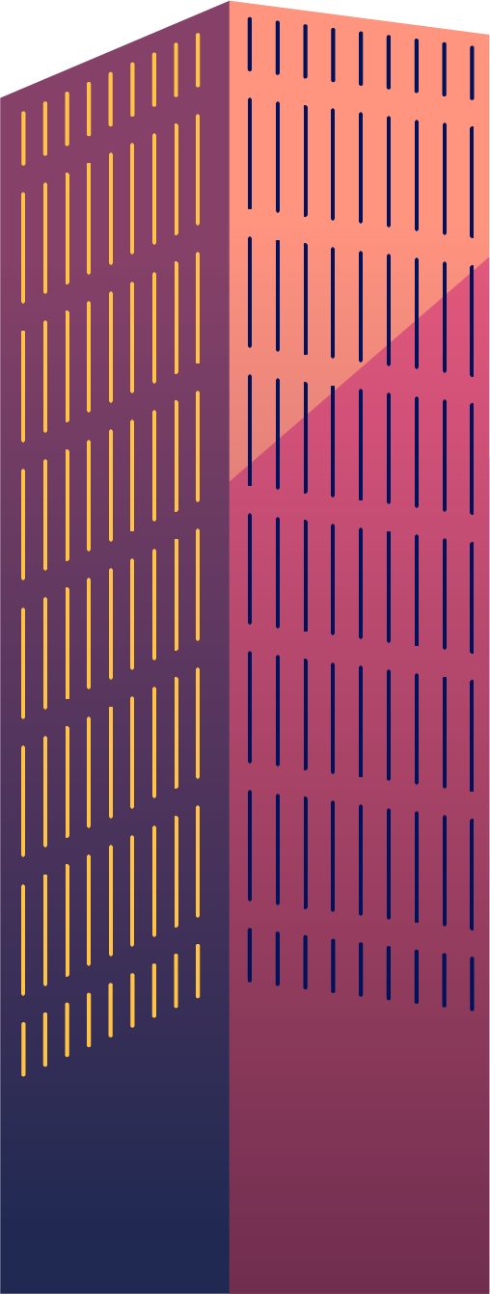
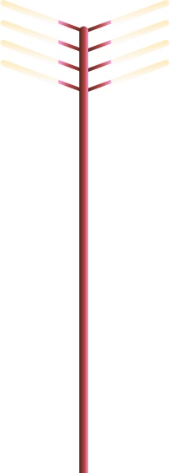
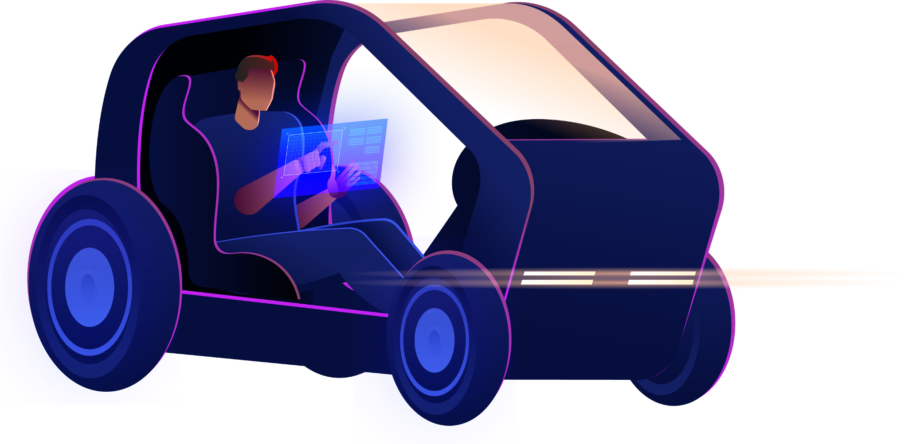


Autonomous Robot with Obstacle Avoidance and Auto Parking
Design and Implementation

Slide 2
Team members
Name | Id
Andrew Botros Ayad | 20201322493
Eriny Wagih Masoud | 2022513146
Marina George Zarif | 20221443430
Carine Emad Sanad | 20221440878
Sandra Wassim Youssef | 20221440830
Seveen Samir Wakim | 2103117

Slide 3
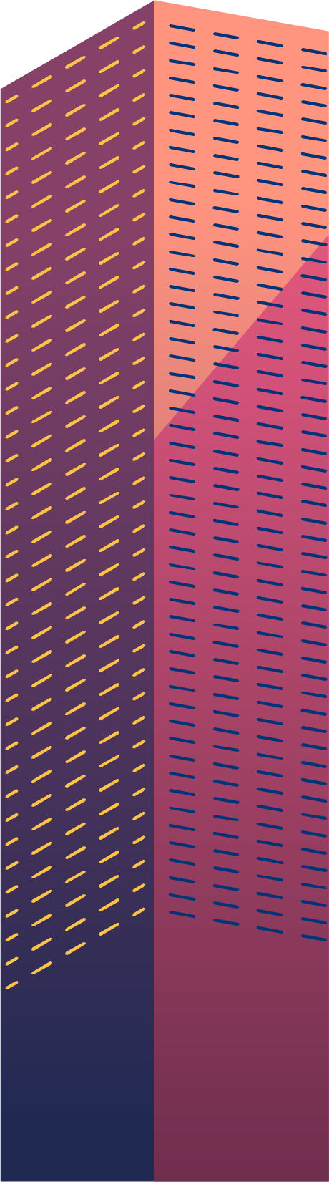
Table of contents
01
05
02
06
03
07
Introduction
Detailed Flowcharts
Problem description
Cost Analysis
System design
Demonstration
04
Solution Implementation
Conclusion
08

Slide 4
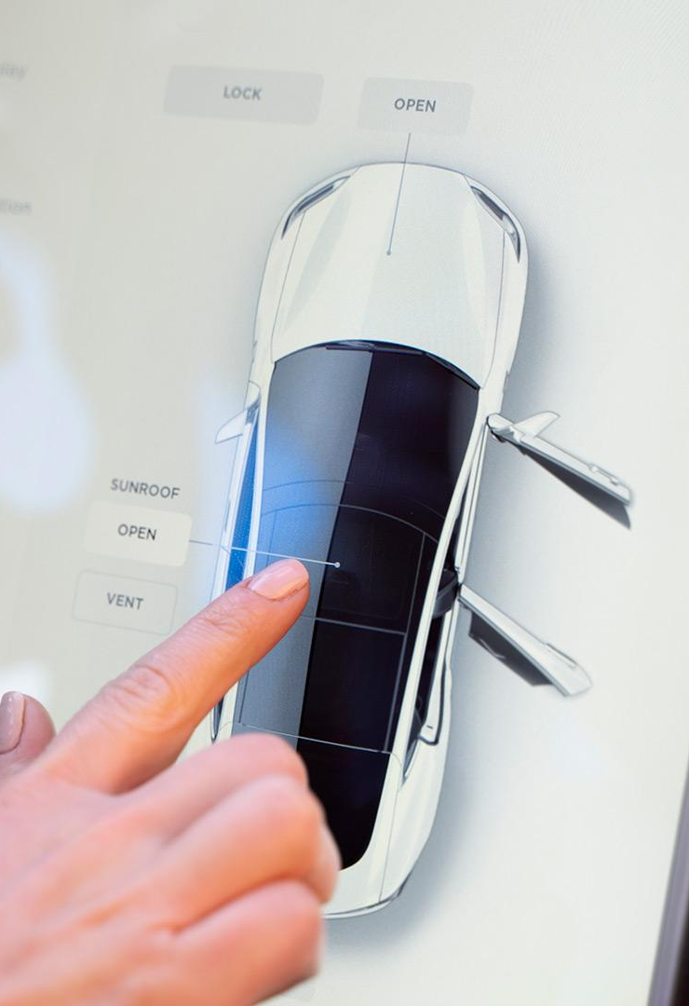

Objective:
Design and implement an autonomous robot capable of navigating its environment, avoiding obstacles, and autonomously parking itself.

Slide 5



01
Introduction

Slide 6
Introduction
This project focuses on creating a robot that can navigate on its own and park itself without human assistance.
We're tackling two main challenges: obstacle avoidance and auto parking.
These capabilities are crucial for making robots safer, more efficient, and more accessible.
By developing this robot, we're contributing to the advancement of autonomous systems that can enhance safety, efficiency, and accessibility in various settings.

Slide 7
Problem Description:
Obstacle Avoidance:
Auto Parking:
Navigating environments cluttered with obstacles poses a significant challenge for autonomous robots. These obstacles can be static, like walls or furniture, or dynamic, such as moving objects or pedestrians. To ensure safe navigation, robots must be equipped with sensors and algorithms capable of detecting obstacles in their path and autonomously plotting alternate routes to avoid collisions.
Parking is a fundamental task for vehicles, and enabling autonomous robots to park themselves efficiently is equally important. Auto parking systems must be able to identify suitable parking spaces, maneuver into them accurately, and avoid collisions with other vehicles or obstacles in the vicinity. This requires advanced sensor technologies and intelligent algorithms to analyze the environment and execute precise parking maneuvers.

Slide 8
System Design:
1. Overview of Hardware Components
2. Interaction of Components
3. Role of Sensors

Slide 9
System Design:
1. Overview of Hardware Components:
The autonomous robot comprises several hardware components working together seamlessly to achieve its objectives:
Motor Control System: Consists of motors (Motor A and Motor B) responsible for driving the robot's movement. Each motor is connected to a motor driver module that regulates its speed and direction.
Sensor Array: Includes various sensors essential for obstacle detection and environment monitoring. These sensors typically include ultrasonic sensors.
Microcontroller Unit (MCU): Acts as the brain of the robot, processing sensor data and executing control algorithms. Common MCUs used in robotics projects include Arduino.
Power Supply: Provides electrical power to the robot's components, typically consisting of batteries.

Slide 10
System Design:
2. Interaction of Components
The MCU receives input signals from the sensor array, which constantly monitors the robot's surroundings for obstacles and other relevant environmental data.
Based on the sensor inputs, the MCU executes control algorithms to determine the robot's movement commands. These commands are then transmitted to the motor control system, directing the motors to adjust speed and direction accordingly.
The motor control system translates the movement commands into physical motion, allowing the robot to navigate its environment, avoid obstacles, and perform parking maneuvers autonomously.
Continuous feedback loops ensure that the robot can adapt its behavior in real-time based on changes in the environment, such as the presence of new obstacles or the availability of parking spaces.

Slide 11
System Design:
3. Role of Sensors:
Obstacle Detection: Ultrasonic sensors are commonly used for obstacle detection in robotics projects. These sensors emit ultrasonic waves and measure the time taken for the waves to reflect back from nearby objects. By calculating the distance to obstacles, the robot can detect potential collisions and adjust its path accordingly.
Parking Maneuvering: Ultrasonic sensors play a crucial role in parking maneuvers by accurately measuring distances between the robot and surrounding objects, such as walls or other vehicles. This data enables the robot to determine the size and availability of parking spaces and execute precise parking maneuvers without colliding with obstacles.
Environment Monitoring: In addition to obstacle detection, sensors may also provide data on environmental conditions such as lighting levels, temperature, or humidity. This information can be used to optimize the robot's navigation and parking strategies, ensuring optimal performance under various operating conditions.

Slide 12
Solution Implementation:
Obstacle Avoidance Code:
Discussion on
Algorithms:
Parking Code:
This code controls the robot’s movements using motor control functions and adjusts its path based on sensor readings. It helps the robot navigate around obstacles by changing direction and speed when obstacles are detected.
How it Addresses Challenges:
By reacting to sensor data, the robot can avoid collisions autonomously, ensuring safe navigation in cluttered environments.
This code utilizes ultrasonic sensors to detect obstacles and determine if there's a parking space available. It then guides the robot through a series of maneuvers to park in the space safely.
How it Addresses Challenges:
By using sensors to assess parking space availability, the robot can perform parking maneuvers without human assistance, demonstrating its ability to handle complex tasks.
Both algorithms rely on sensor data to make decisions about the robot's movement. The obstacle avoidance algorithm prioritizes safety by avoiding collisions, while the parking algorithm focuses on efficiency and precision during parking maneuvers.
Obstacle Avoidance Algorithm: Reacts to sensor data to avoid collisions and navigate safely.
Auto Parking Algorithm: Utilizes sensors to assess parking space availability and execute parking maneuvers autonomously.

Slide 13
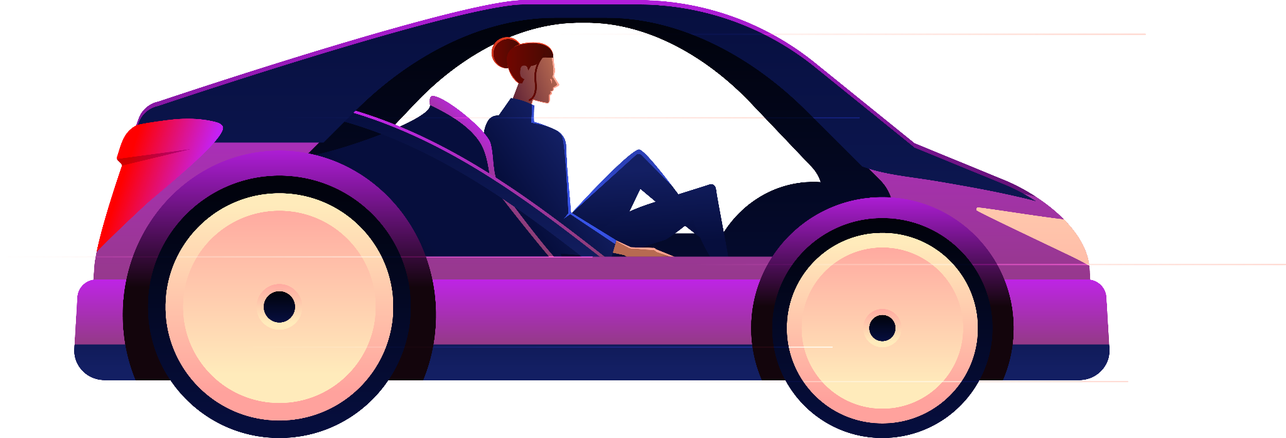
Cost analysis:
Elements we use | Number | Costs
Robot chassis 4WD | pair | 135
Yellow wheels | 4 | 4*25=100
Ultrasonic distance sensor | 3 | 3*45=135
Ultrasonic holder | 3 | 3*15=45
DC gear motor | 2 | 2*40=80
total | 495
Total almost 495 EGP,
we saved 659EGP

Slide 14


Demonstration
Video of our autonomous robot car

Slide 15
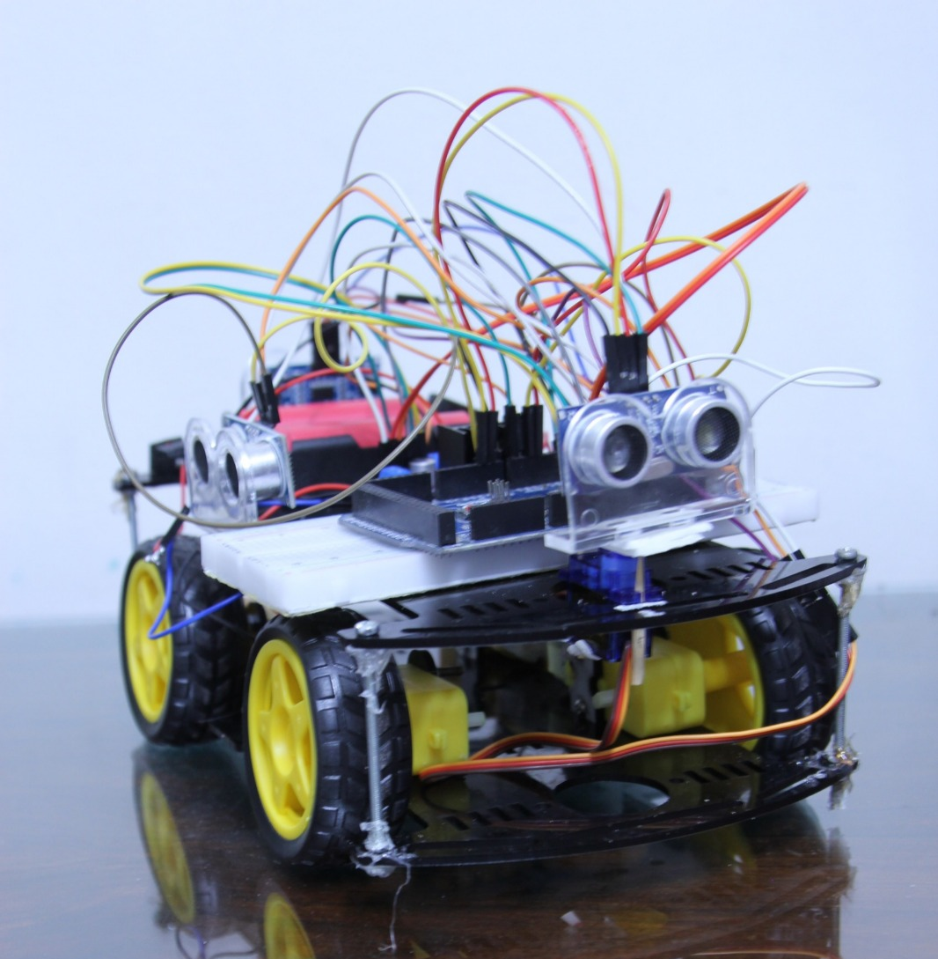
An image for our robot

Slide 16
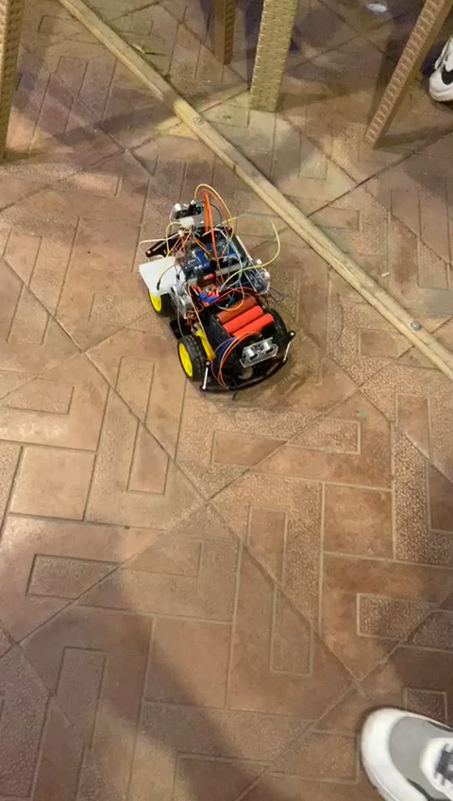
Obstacle avoidance:

Slide 17
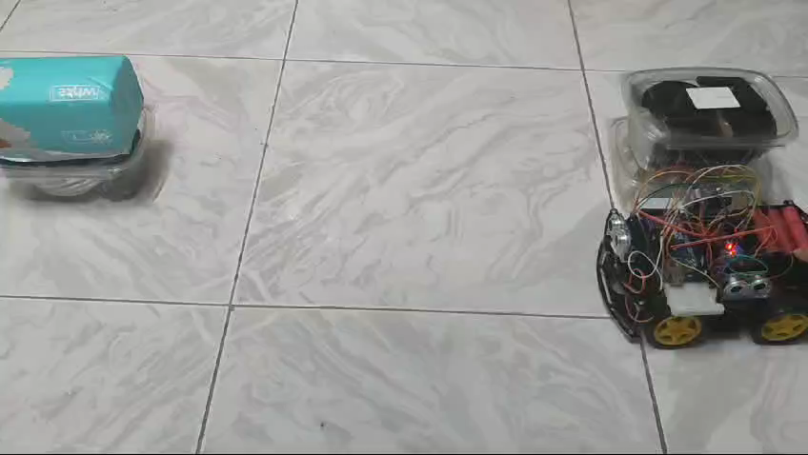
Auto Parking:

Slide 18
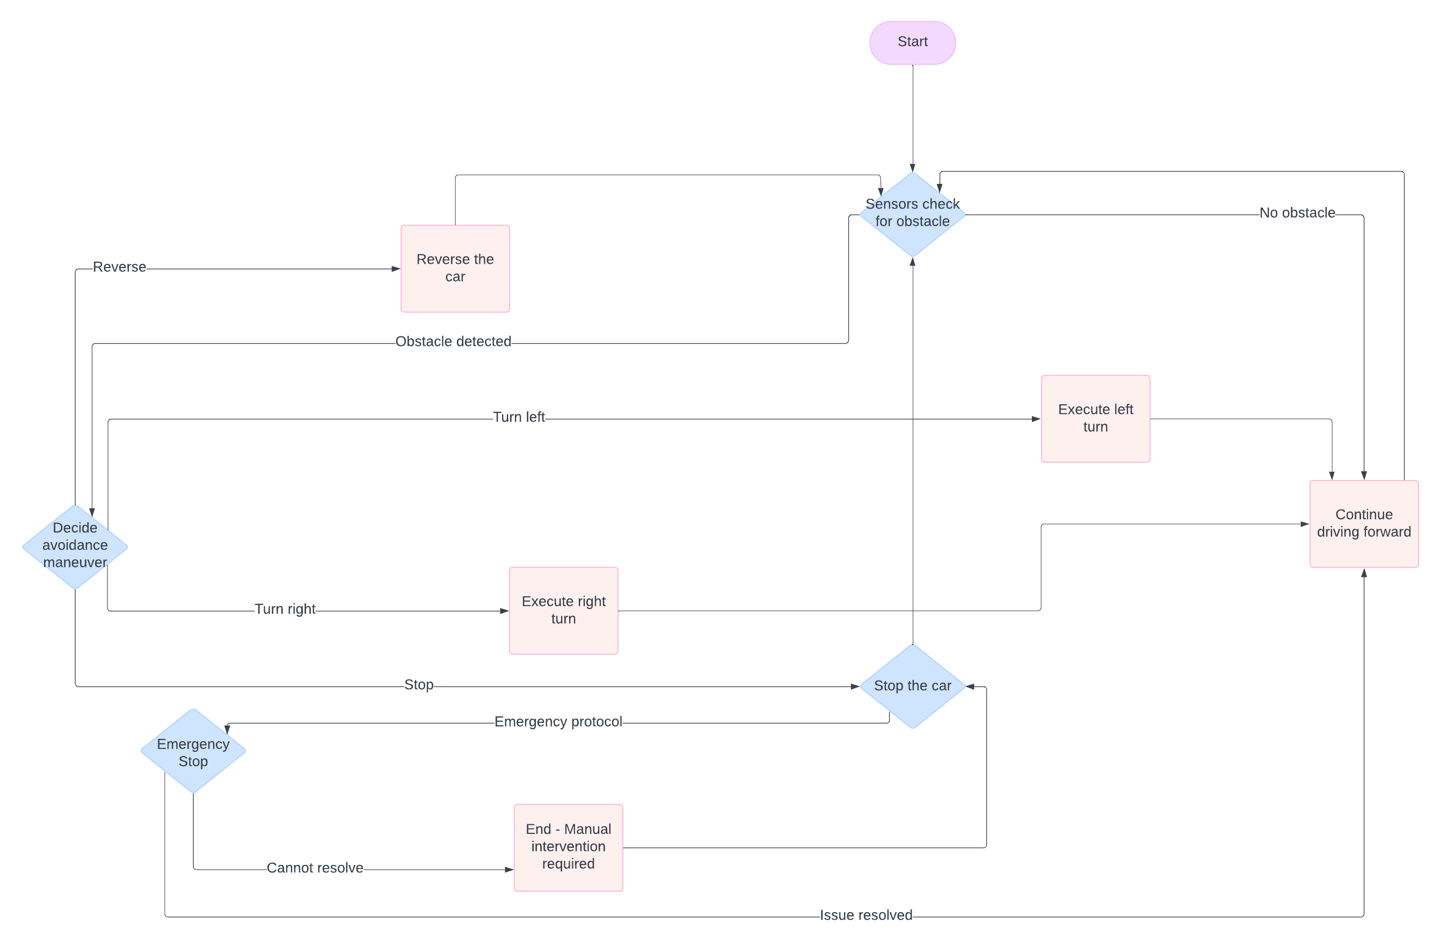
FlowChart Diagrams
01
Obstacle avoidance:

Slide 19
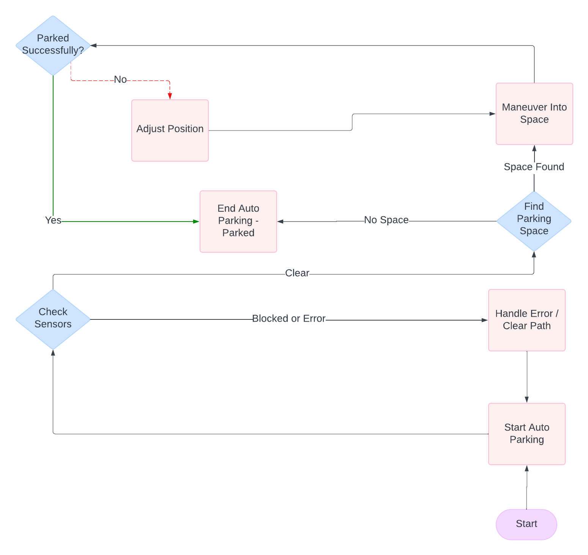
FlowChart Diagrams
02
Auto parking:

Slide 20
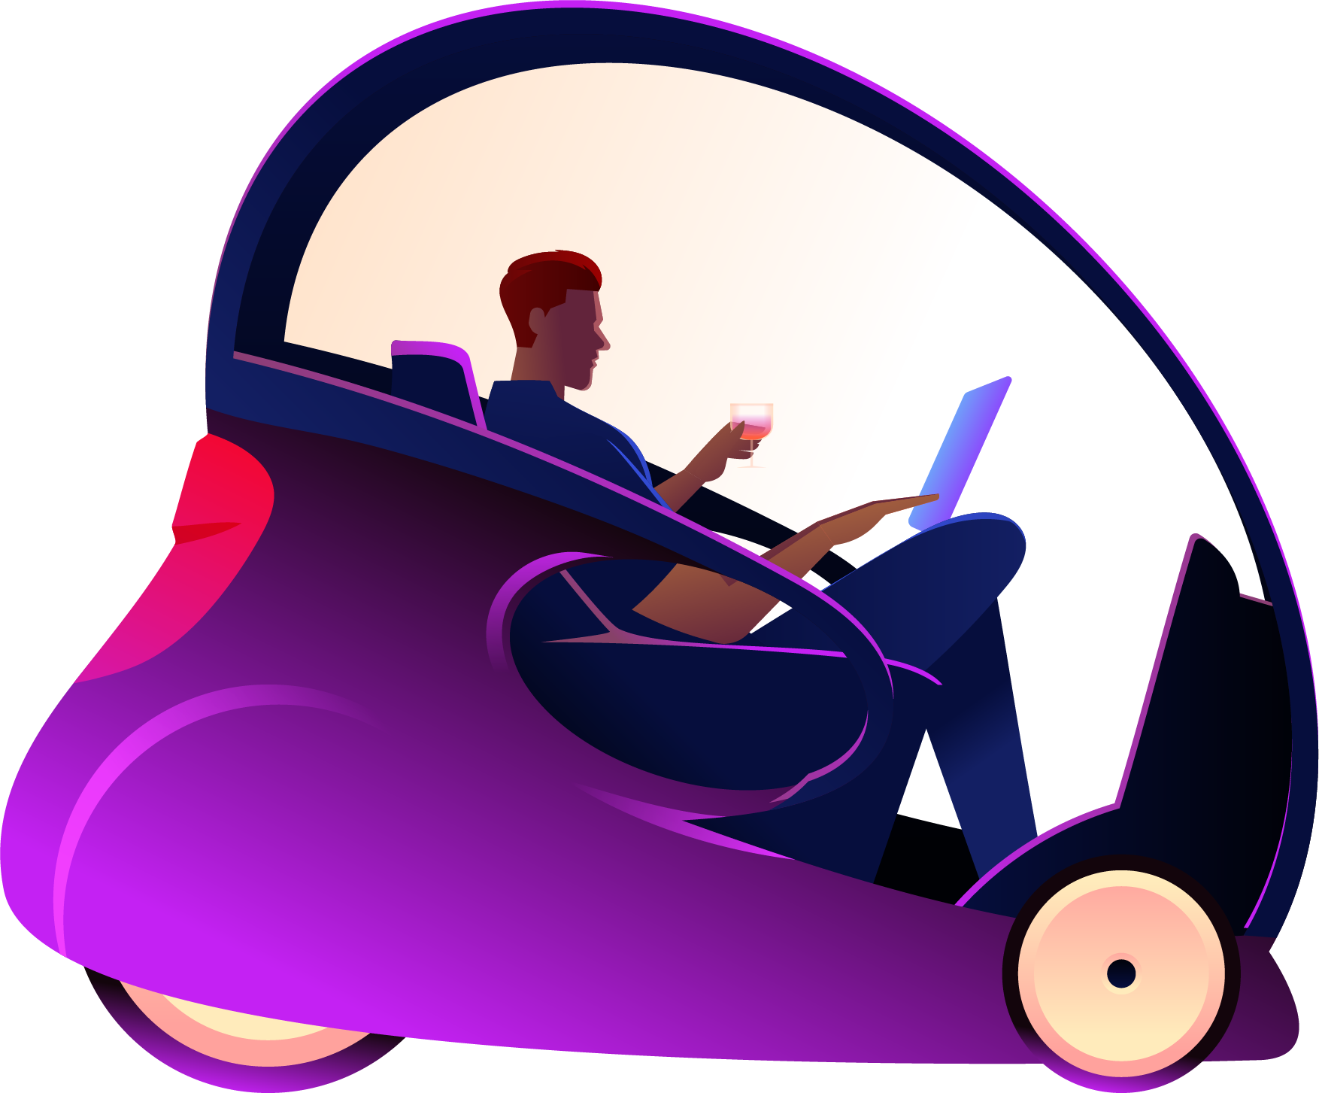
Thanks!
Thanks for: Dr. Mohamed El Habrouk
Eng. Ahmed El Dawwy

